Slide 1
WEBSITE REDESIGNING
🔨By Team Design To Code

Slide 2
Why We Have Taken This Problem?

Slide 3
Poor User Interface.
Difficult to navigate.

Slide 4

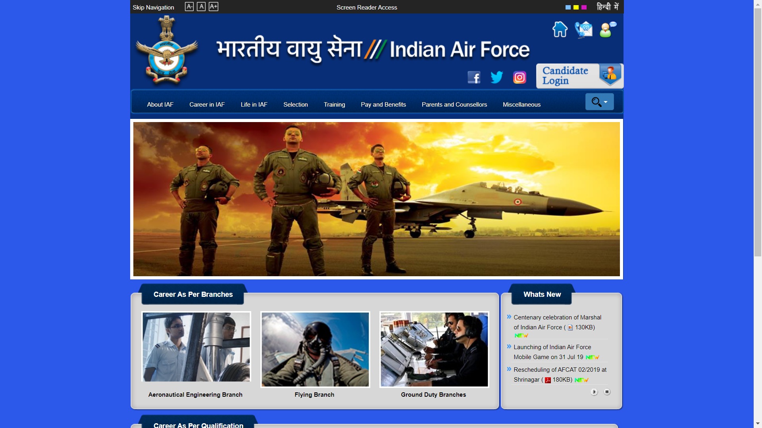
Current Problem

Slide 5

Our Solution

Slide 6
Improved User Interface.
Easy to navigate.

Slide 7

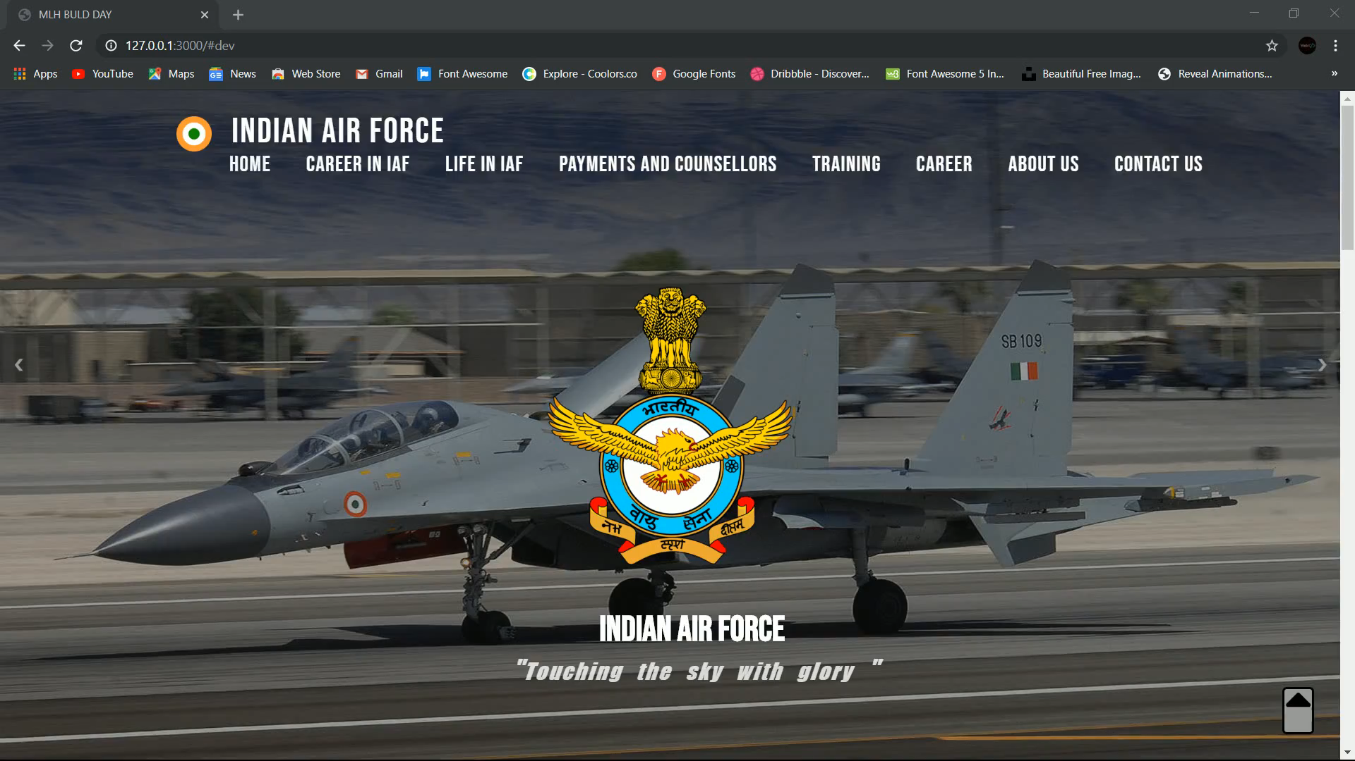
Demo

Slide 8
Tech we Used
HTML
CSS
JAVASCRIPT

Slide 9
Future Scope
We will try to create more creative UI and UX.
To become full time UI/UX designer.

Slide 10
Thanks!
You can find us at:
@Tusharakhil
@Avinash22032000

